Slide 1

Test Craft

Slide 2
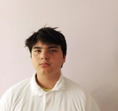
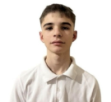
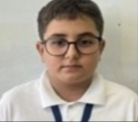
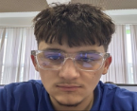
OUR TEAM
Scrum trainer
Denis Paspalov
BackEnd developer
Petar Kapralev
BackEnd developer
Rostislav Ivanchev
Quality engineer Yanko Yanev

Slide 3
Stages of work
Stage 1
Stage 2
Stage 3
Stage 4
1st week​
2nd week
3rd week
4th week
We assigned everyone's roles and began the project.
We started developing the main components of the project and made progress on the initial tasks.
We were almost done with the project and
we began working on the documentation.
We completed the project and finished the presentation.

Slide 4






Used Technologies

Slide 5
Thank you for your attention,
and now, let's head to the site!

